Slide 1


Pharmacist-Physician Collaboration Intervention
Overview
Notes:
Welcome to an overview of the Pharmacist-Physician Collaboration Intervention.

Slide 2
What is a Pharmacist-Physician Collaboration?
An intervention that utilizes practice- or community-based pharmacist to outreach to at-risk patients to provide counseling on heart health-related issues such as medication adherence and condition management.
Notes:
What is our pharmacist-physician collaboration? An intervention that utilizes practice- or community-based pharmacist to outreach to at-risk patients to provide counseling on heart health-related issues such as medication adherence and condition management.

Slide 3
Why
Health
Coaching?
40-50%
The percentage of overall health determinants that are lifestyle-related
55%
The percentage of Tennesseans with multiple chronic conditions
24
The average number of prescription medications for people with 3-4 chronic conditions
16.5
The average number of minutes PCPs get to spend with their patient
18.6
The average number of minutes for PCP to complete the EMR for each patient
>$5 billion
The direct medical cost associated with treating diabetes, hypertension and cardiovascular disease in Tennessee over a 1-year period
7
The number of established CPT codes that will reimburse different types of lay pharmacist counseling sessions with patients
Notes:
Why do we have such a need for pharmacist counseling to assist our primary practice?

Slide 4
Why do we use MI as our approach?
Our pharmacist counseling approach is motivational interviewing
  Excellent evidence-base with over 1500 clinical trials
  Successful track record in Tennessee primary care clinics
  Skill-set appropriate for professional or lay staff
Notes:
Our pharmacist counseling approach is based on the evidence-based motivational interviewing or MI approach, which has over 1500 clinical trials now that demonstrate its efficacy across multiple settings and populations including primary care. In addition, our MODEL clinical trial demonstrated that an MI-based approach could be successfully integrated into Tennessee primary care clinics. And, in addition to pharmacists, this skill set is appropriate for both the professional or clinical staff and your lay staff, such as health coaches or community health workers. As part of our study, we provide free MI training for two staff from your practice.

Slide 5
Pharmacist-Physician Collaboration Intervention
Flexible
Tailored
Effective
Sustainable
Notes:
We wanted our intervention to address heart health issues and to be flexible, tailored, effective and sustainable.

Slide 6
Pharmacist-Physician Collaboration Intervention
Flexible –
Use new or existing staff
Use existing pharmacists or collaborate with a community pharmacy
Tailored – Menu of targeted behaviors
Effective – Training & competency development
Motivational Interviewing
Sustainable – Reimbursement mechanisms
Annual Wellness Visit
Blood pressure control
Transitional care
Diabetes control
Behavioral health & SDOH
Obesity
Depression screening
Cardiovascular risk counseling
Obesity counseling
Tobacco cessation
Diabetes self-management
Chronic Condition & Lifestyle Management
Community Health Worker
Patient Navigation
Transitional care
Chronic care management
Tobacco cessation
Clinical pharmacist, retail pharmacist
with assistance from
pharmacy
technician
Notes:
To that end, you can use existing pharmacists or collaborate with a community pharmacist. Your pharmacist can be a clinical or retail pharmacist, with assistance from a pharmacy tech.

Slide 7
Pharmacist-Physician Collaboration Intervention
Flexible –
Use new or existing staff
Medical assistant
Tailored – Menu of targeted behaviors
Effective – Training & competency development
Motivational Interviewing
Sustainable – Reimbursement mechanisms
Annual Wellness Visit
Health coach
Community health worker
Social worker
Care manager
Diabetes educator
Depression screening
Cardiovascular risk counseling
Obesity counseling
Tobacco cessation
Diabetes self-management
Chronic Condition & Lifestyle Management
Community Health Worker
Patient Navigation
Transitional care
Chronic care management
Tobacco cessation
Adherence to blood pressure and diabetes medications
Blood pressure monitoring
Diabetes control
Notes:
You can tailor your intervention by selecting from a menu of targeted behaviors, such as tobacco cessation, adherence to blood pressure and diabetes medications, blood pressure monitoring, or diabetes control.

Slide 8
Pharmacist-Physician Collaboration Intervention
Flexible –
Use new or existing staff
Medical assistant
Tailored – Menu of targeted behaviors
Effective – Training & competency development
Motivational Interviewing:
Sustainable – Reimbursement mechanisms
Annual Wellness Visit
Health coach
Community health worker
Diabetes educator
Blood pressure control
Cholesterol control
Diabetes control
Obesity
Depression screening
Cardiovascular risk counseling
Obesity counseling
Tobacco cessation
Diabetes self-management
Tobacco cessation
Chronic care management
Engaging patients
Focusing on priority areas
Evoking motivation to change
Planning and goal-setting
Notes:
We assist in ensuring the efficacy of the intervention by providing your pharmacist with training, competency development, and mentoring.

Slide 9
Pharmacist-Physician Collaboration Intervention
Flexible –
Use new or existing staff
Medical assistant
Tailored – Menu of targeted behaviors
Effective – Training & competency development
Motivational Interviewing
Sustainable – Reimbursement mechanisms
Tobacco cessation
Health coach
Community health worker
Diabetes educator
Blood pressure control
Cholesterol control
Diabetes control
Obesity
Chronic Condition & Lifestyle Management
Community Health Worker
Patient Navigation
Tobacco cessation
Obesity management
Intensive CVD
behavioral therapy
Diabetes education
Chronic care management
services
Remote patient monitoring
Notes:
And we have compiled multiple CPT codes that are already on the books as reimbursement mechanisms for the valuable services that your pharmacist will provide. Lastly, we can provide assistance with incorporating these codes into your practice workflow.

Slide 10
Pharmacist-Provider Collaborative Intervention
Flexible – inhouse or outsourced
Use existing pharmacists or collaborate with a community pharmacy
Tailored –
menu of
targeted behaviors
Effective – training and competency development
Sustainable – reimbursement mechanisms
Tobacco cessation
Tobacco cessation
Clinical pharmacist, retail pharmacist
with assistance from pharmacy
technician
Adherence to blood pressure and diabetes medications
Blood pressure monitoring
Diabetes control
Diabetes education
Chronic care management services
Obesity management
Intensive CVD behavioral therapy
Remote patient monitoring
Motivational Interviewing:
  Engaging patients
  Focusing on priority areas
  Evoking motivation to change
  Planning and goal-setting
Notes:
All together your intervention has the potential to have a significant impact on the heart health of your high-risk patient panel.

Slide 11

Your Toolkit
Notes:
Your complete toolkit for this intervention is online; your practice facilitator will be going over these resources with you. There are many helpful documents that you can access or download.

Slide 12
Step-by-Step Process
Step 1
Identify the key contact staff from your practice
Step 2
Meet with your Practice Facilitator to tailor your intervention
Step 3
Identify your pharmacist partner
Step 4
Register pharmacist staff for training and complete certification program
Step 5
Meet with Network Evaluation Team
Step 6
Train pharmacist and office staff to use CPT billing codes
Step 7
Create process to identify high-risk patients for telephone outreach and for provider referrals
Step 8
Introduce pharmacist intervention and pharmacist (if new) to providers
Step 9
Begin telephonic outreach, scheduling, pharmacist counseling, and documentation
Step 10
Provide ongoing support for pharmacist partner
Notes:
Our toolkit has a detailed step-by-step process that will guide you through the development, implementation and evaluation of this intervention. And your practice facilitator and our Network evaluation team will support you every step along the way.

Slide 13
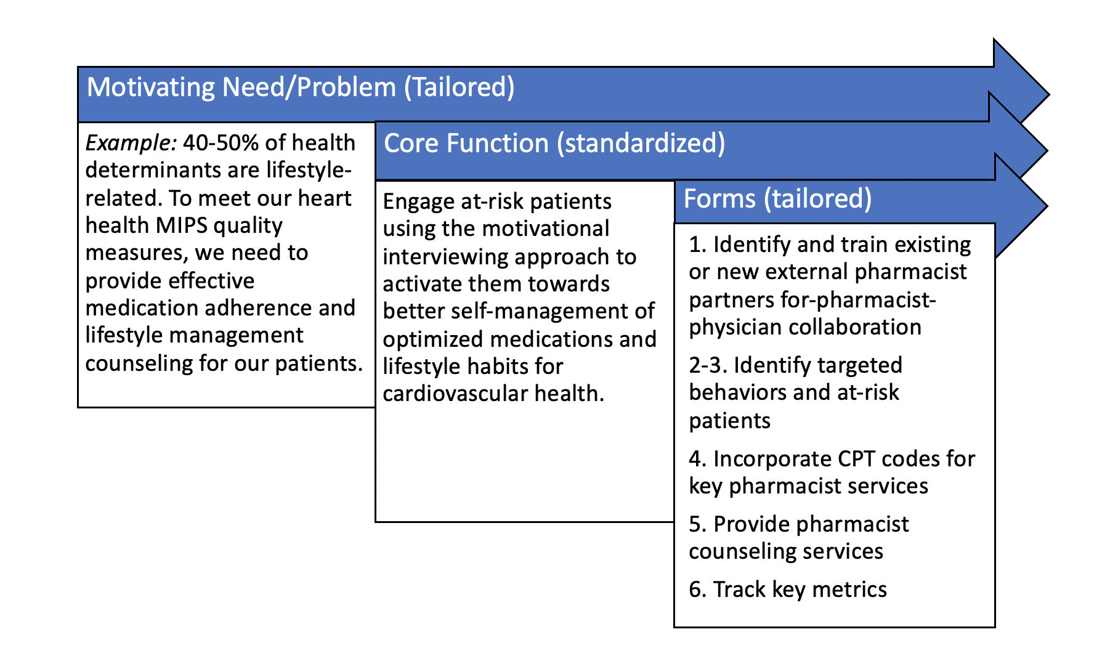
1st Step: Function & Form Matrix
Notes:
Your first step in getting started on this intervention is to fill out the Function & Form Matrix that you can find on the toolkit website. Your practice facilitator will be happy to help you make some of the decisions that will tailor your plan to meet your unique needs and objectives.

Slide 14
Questions & Comments
Notes:
We hope that you are as excited about this intervention as we are! Let us know if you have any questions.

